Slide 1
ECE 350 Final Project
Student: Max Smith
Mentor: Nathan Choe
Professor: Dr. Board

Slide 2
Overview
Motivation – processor tediousness
Goal – streamline processor development
Deliverable – easy, accessible assembler application
What’s in the box?
How to interact with box?
Assembler
Instructions
Assembled Code

Slide 3


Implementation
MV (C?) Model
Java Backend
User Interface
Web
JavaFX
CMD line
Output Preferences
Assembler
ISA
Instructions
Assembled Code
Register Names

Slide 4
Java Stuff
Data Driven (user/config)
ISA (xml)
Registers (properties)
Extendibility
Polymorphism
Reflection
Robust
Filter
Test Driven Dev (TDD)
Design patterns
Command pattern, factory
Objects
ISA, IO, Instruction, Filter

Slide 5
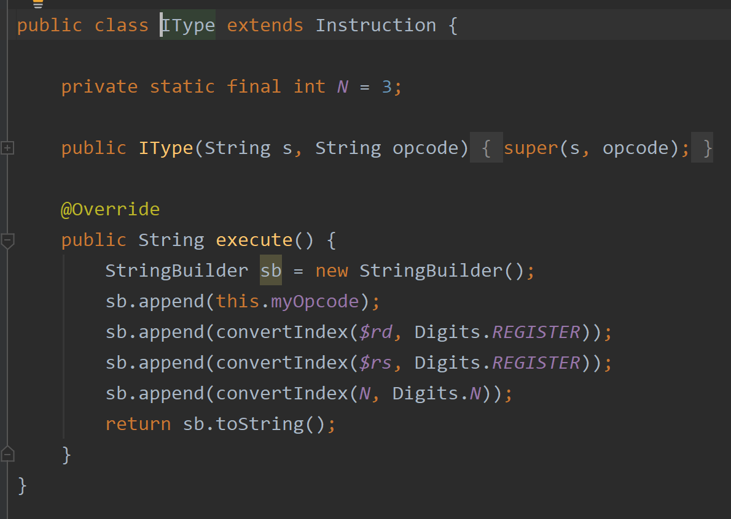
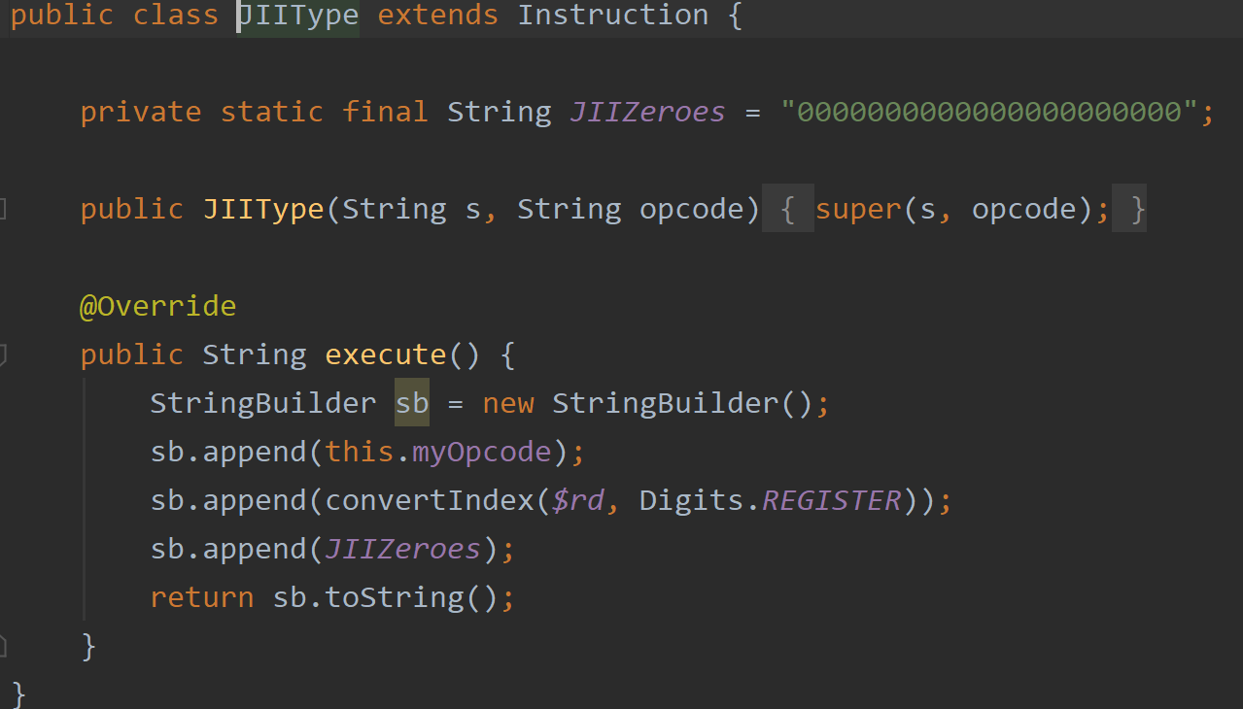
Inheritance/Command Design

Slide 6
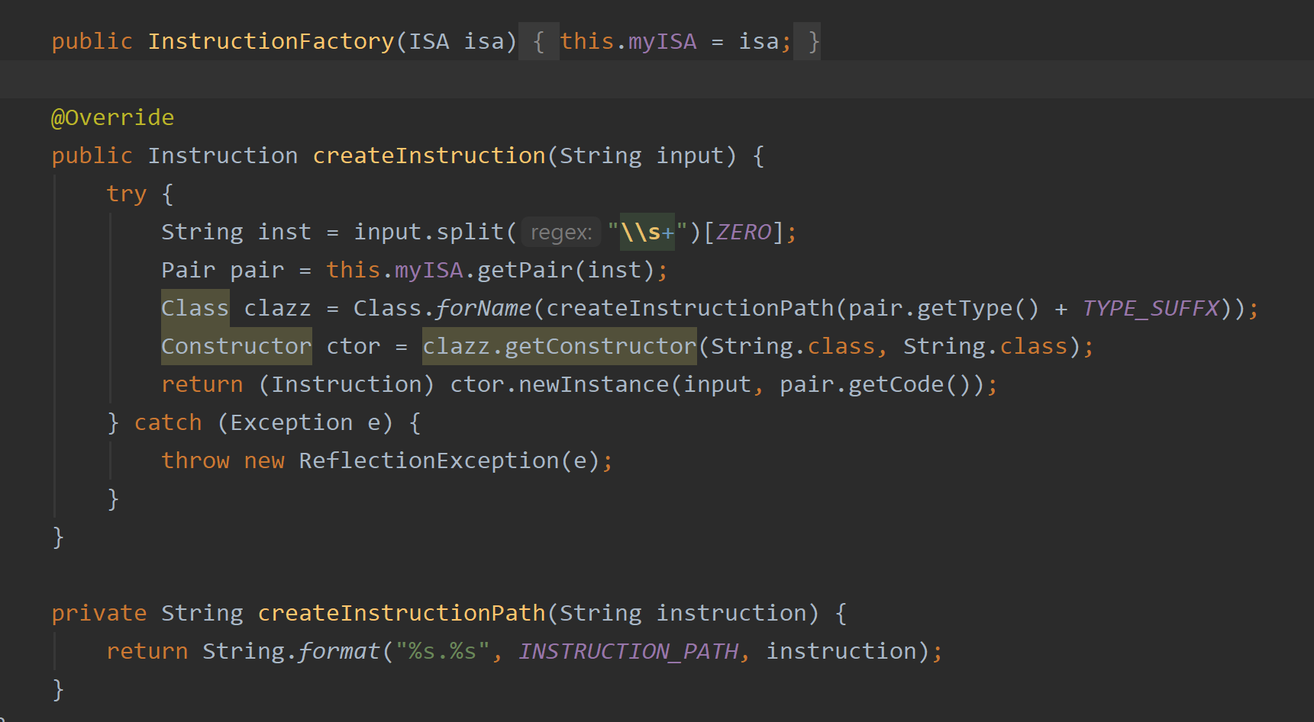
Factory

Slide 7
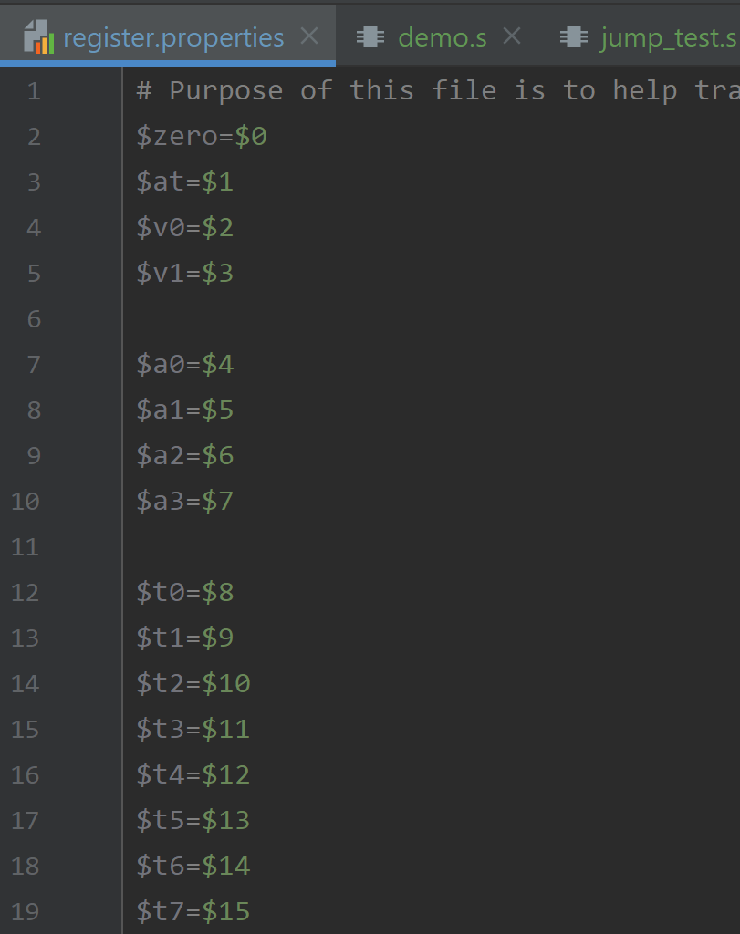
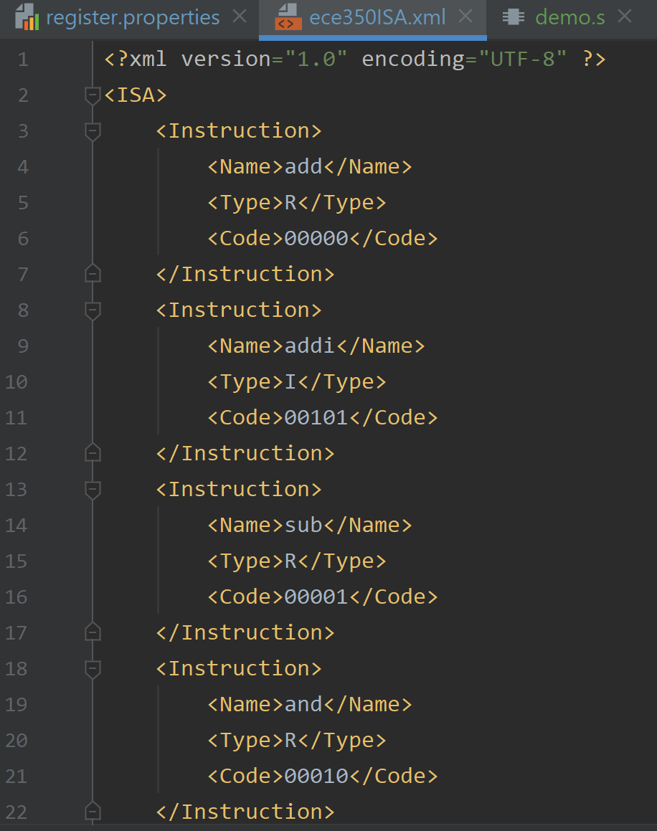
Data Driven Design

Slide 8
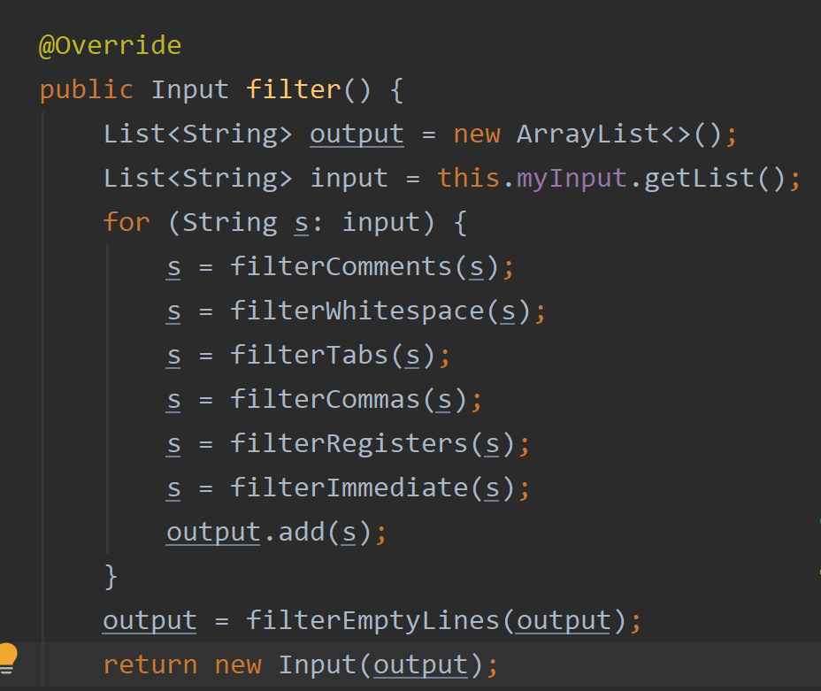
Filtering

Slide 9
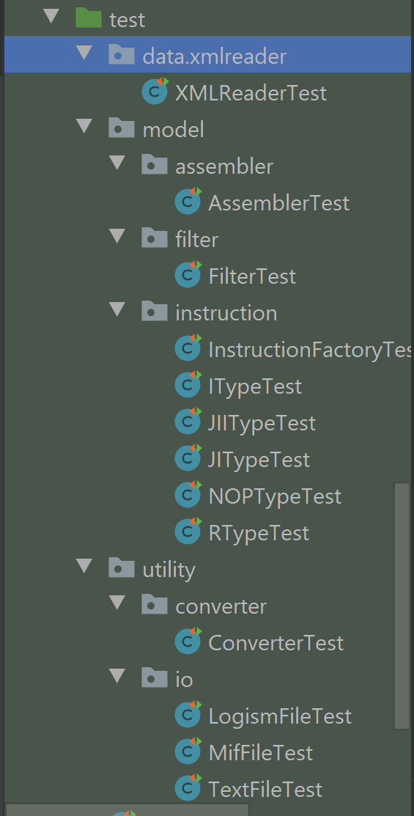
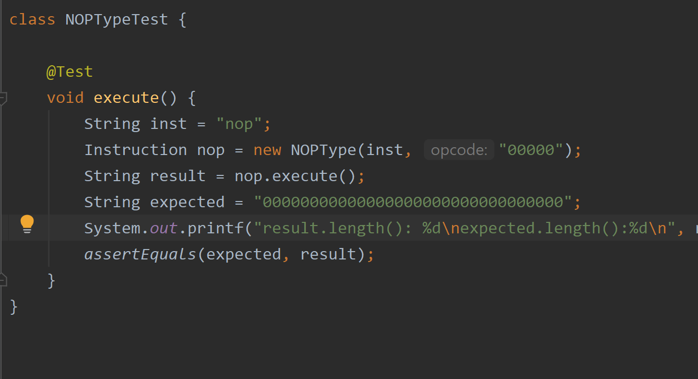
Test Driven Development

Slide 10
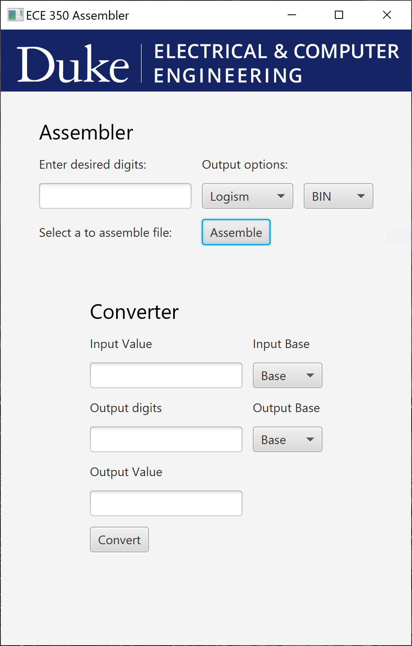
UI
Web attempt
Tomcat Apache
Java Spring Boot
AWS Codestar
JavaFX
UI dependency
Large exe download

Slide 11
Challenges
Interface

Slide 12
Questions?

